Slide 1
User Research

Slide 2
WITH THE HELP OF TECH HOW CAN WE BRING DEVELOPMENT IN BACKWARD ARES OF INDIA ( OR UNORGNISED SECTORS OF INDIA)

Slide 3
The Areas Which Comes Under Unorganized Sectors

Slide 4
STATE | BACKWARD AREAS
Andhra Pradesh | Anantapur, Chittoor, Cuddapah, Karimnagar, Khammam, Kurnool, Mahbubnagar, Medak, Nalgonda, Nellore, Nizamabad, Ongole, Srikakulam and Warangal
Assam | Cachar, Goalpara, Kamrup, Lakhimpur, Mikir Hills, North Cachar Hills and Nowgong
Bihar | Aurangabad, Begusarai, Bhagalpur, Bhojpur, Darbhanga, East Champaran, Gaya, Madhubani, Monghyr, Muzaffarpur, Nalanda, Nawadah, Palamau, Purnea, Saharsa, Samastipur, Santal Parganas, Saran, Sitamarhi, Siwan, Vaishali and West Champaran
Gujarat | Amreli, Banas Kantha, Bharuch, Bhavnagar, Junagadh, Kutch, Mahesana, Panch Mahals, Sabar Kantha and Surrendranagar
Haryana | Bhiwani, Hissar, Jind and Mahendragarh
Himachal Pradesh | Chamba, Hamirpur, Kangra, Kinnaur, Kulu, Lahul and Spiti, Sirmur, Solan and Una
Jammu and Kashmir | Anantnag, Baramula, Doda, Jammu, Kathua, Ladakh, Punch, Rajauri, Srinagar and Udhampur
Karnataka | Belgaum, Bidar, Bijapur, Dharwar, Gulbarga, Hassan, Mysore, North Kanara, Raichur, South Kanara and Tumkur
Kerala | Alleppey, Cannanore, Malappuram, Trichur and Trivandrum
Madhya Pradesh | Balaghat, Bastar, Betul, Bilaspur. Bhind, Chhatarpur, Chhindwara, Damoh, Datia, Dewas, Dhar, Guna, Hoshangabad, Jhabua, Khargone, Mandla, Mandsaur, Morena, Narsimhapur, Panna, Raigarh, Raipur, Raisen, Rajgarh, Rajnandgaon, Ratlam, Rewa, Sagar, Sehore, Seoni, Shajapur, Shivpuri, Sidhi, Surguja, Tikkamgarh and Vidisha

Slide 5
State | Backward Areas
Orissa | Balasore, Bolangir, Dhenkanal, Kalahandi, Keonjhar, Koraput, Mayurbhanj and Phulbani
Punjab | Bhatinda , Ferozepur, Gurdaspur, Hoshiarpur, and Sangrur
Rajasthan | Alwar, Banswara, Barmer, Bhilwara, Churu, Dungarpur, Jaisalmer, Jalor, Jhalwar, Jhunjhunu, Jodhpur, Nagaur, Sikar, Sirohi, Tonk and Udaipur
Sikkim | The whole of the State
Tamil Nadu | Dharmapuri kanyakumari, Madurai, North Arcot, Ramanathapuram, South Arcot, Thanjavur and Tiruchirapalli
Tripura | The whole of the State
Maharashtra | Aurangabad, Bhandara, Bhir, Buldhana, Chandrapur, Dhulia and Jalgaon
Manipur | The whole of the State
Meghalaya | The districts of Garo Hills, Jaintia Hills and Khasi Hills
Nagaland | The whole of the State
Uttar Pradesh | Almora, Azamgarh, Baharaich, Ballia, Banda, Bara Banki, Basti, Budaun, Bulandshahr, Chamoli, Deoria, Etah, Etawah, Faizabad, Farrukhabad, Fatehpur, Garhwal, Ghazipur, Gonda, Hamirpur, Hardoi, Jalaun, Jaunpur; Jhansi Mainpuri, Mathura, Moradabad, Pilibhit, Pithoragarh, Pratapgarh. Rae Bareli, Rampur, Shahjahanpur, Sitapur, Sultanpur, Tehri-Garhwal, Unnao and Uttarkashi

Slide 6
STATE | BACKWARDAREAS
West Bengal | Bankura, Birbhum, Burdwan, Cooch Behar, Darjeeling, Hooghly, Jalpaiguri, Malda, Midnaporc, Murshidabad, Nadia, Purulia and West-Dinajpur
Andaman and Nicobar Islands | The whole of the Union territory
Arunachal Pradesh | The whole of the Union territory
Dadra and Nagar Haveli | The whole of the Union territory
Goa, Daman and Diu | The whole of the Union territory
Mizoram | The whole of the Union territory
Lakshadweep | The whole of the Union territory
Pondicherry | The whole of the Union territory

Slide 7
PROBLEMS IN RURAL DEVELOPMENT
People related problems
Agricultural related problems
Infrastructure related problems
Economic problems
Leadership related problems
Administrative problems

Slide 8
People Related Problems
Traditional way of thinking.
Poor understanding.
Low level of education to understand developmental efforts and new technology.
Deprived psychology and scientific orientation.
Lack of confidence.
Poor awareness.
Low level of education.

Slide 9
AGRICULTURE RELATED PROBLEM
Lack of expected awareness, knowledge, skill and attitude.
Unavailability of inputs.
Poor marketing facility.
Insufficient extension staff and services.
Multidimensional tasks to extension personnel.
Small size of landholding.

Slide 10
INFRASTRUCTURAL RELATED PROBLEM
Water
Electricity
Transport
Educational institutions
Communication
Health
Employment
Storage facility etc

Slide 11
ECONOMIC PROBLEMS
Unfavourable economic condition to adopt high cost technology.
High cost of inputs.
Under privileged rural industries
lack of advance technology

Slide 12
LEADERSHIP RELATED PROBLEM
Leadership among the hands of inactive and incompetent people.
Self interest of leaders.

Slide 13
ADMINISTRATIVE PROBLEMS
Political interference.
Lack of motivation and interest.
Unwillingness to work in villages.
Improper utilization of budget.
No proper monitoring of programs and lack in their implementation.

Slide 14
Some Issue Faced By Backward Areas
Poverty
Electricity
Water
Caste System
Education
Female Foeticide
Sanitizing

Slide 15
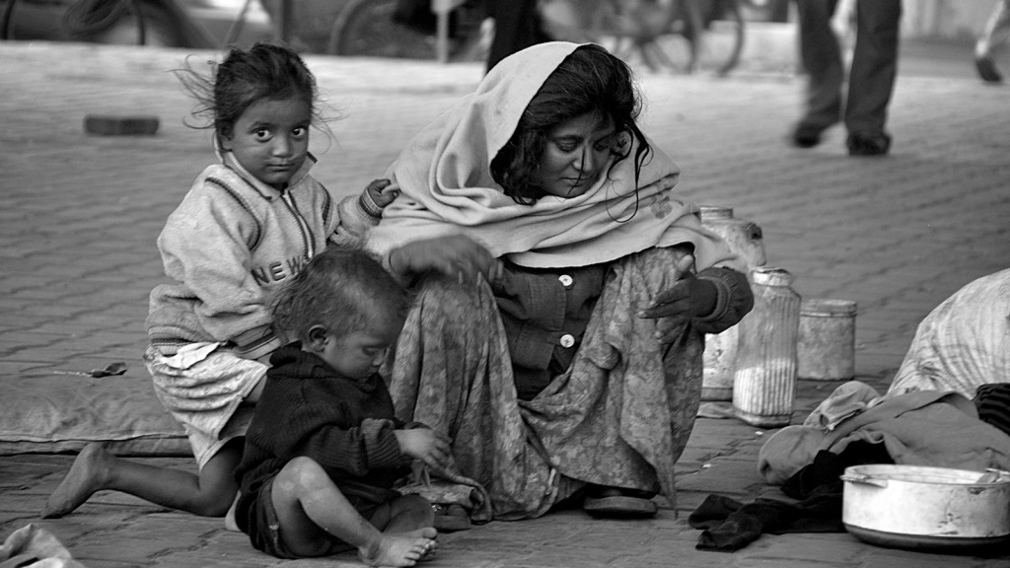
Poverty
50% of Indians don’t have proper shelter;
70% don’t have access to decent toilets (which inspires a multitude of bacteria to host their own disease party);
35% of households don’t have a nearby water source;
85% of villages don’t have a secondary school (how can this be the same government claiming 9% annual growth?);
Over 40% of these same villages don’t have proper roads connecting them.

Slide 16
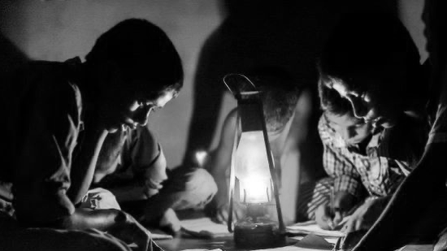
Electricity
It is not uncommon for these areas to have 10-15 hours of blackouts and brownouts every day.
There is a shortfall of about 15,000-20,000 mw of electricity in the country and we require about 140,000 mw of additional capacity with an estimated outlay of Rs 5,50,000 crore.
Because of tremendous shortage of electricity, industrial growth and general life in the country is seriously affected.
The definition of electrified village has changed over the years. Before October 1997,a village was classified as “electrified” if electricity was used within its revenue area for any purpose.
“The key issue that remains ambiguous is what defines “power for all ” — Is it just electrification of villages or to provide quality and adequate electricity to all households?

Slide 17
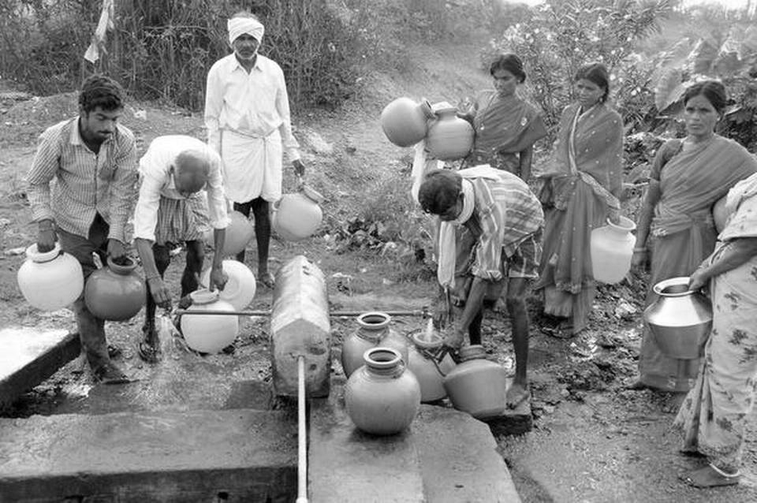
Water
Some facts on the drinking water situation in India that will make you sit up and take note of the problem
It is estimated that only 18% of a total rural population of 833 million Indians have access to treated water. In comparison, 41% of the rural population, or 346 million people, own mobile phones.
Only about one-third of rural households in India are reached by piped water supplies. The balance two-third of rural households is still living ‘beyond the pipe’. The 2011 census estimates that 138 million rural households, or about 685–690 million people, lack access to safe drinking water.
More than half of the pipes in rural areas in India deliver untreated water.
Access to safe water varies greatly from state to state. 36% of the rural population in Andhra Pradesh has access to treated water while, in Bihar, less than 2% of the rural population receives treated water.
The 13% of rural households (approximately 22 million people) served by untreated piped connections along with the 69% of households (approximately 116 million people) that live beyond the pipe, constitute a large potential market for safe water solutions.
Among the venture capital firms that were analysed in the report, only 5 out of 15 had provided funding to firms operating in the drinking water sector.

Slide 18
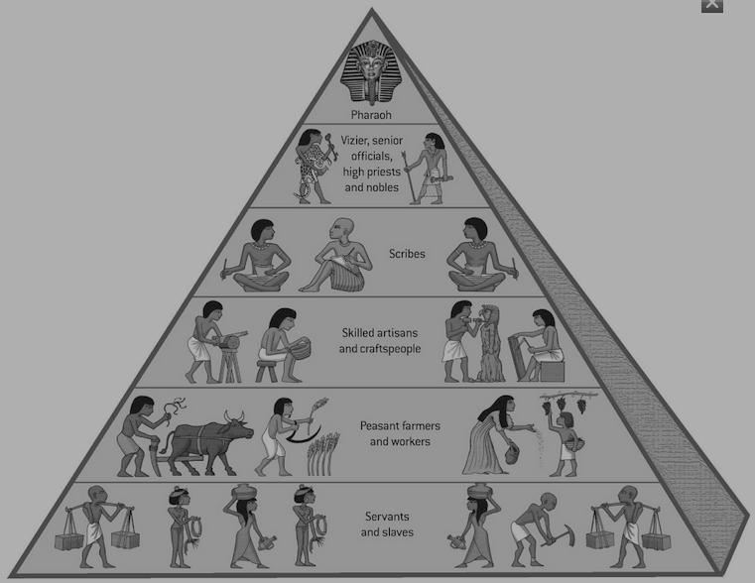
Caste System
In India, the caste system has been a large part of society and still remains, though to a lesser extent, to be a part of society.
Higher classes look down upon the lower classes due to the rigidity of the caste system. This results in hindering the unity.
The caste system is basically a way of dividing people into different social classes, beginning with Brahmins as the highest (Priests and teachers), Kshatriyas (warriors and rulers), Vaisyas (farmers, merchants, and artisans), and Sudras (laborers).
Untouchables, also known as Harijans or Dalits, fall outside of the caste system all together.
These were the original caste groupings as made clear by one Hindu Holy Scripture called the Bhagvad Gita.
Caste system is also held responsible for some religious conversions.
evelopment and advancement gets hindered due to the deep rooted caste system.

Slide 19
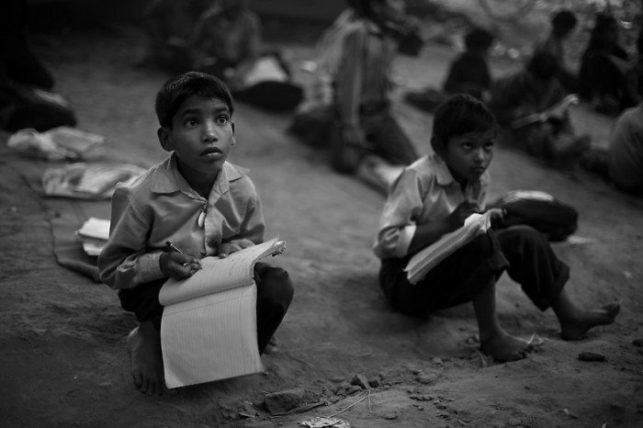
Education
Lack of proper transportation. Most villages have poor connectivity from one place to another and that is often one of the main reason why, despite efforts by local governing bodies to build schools, often go in vain. Children, most of the time have to walk miles to reach these government funded schools and this often demotivate them to attend school on a regular basis.
People belonging to remote rural areas have meagre incomes, which at times is too less to sustain a family of maybe four or five. Most likely, children from these families won’t be sent to schools, instead would be asked to assist the earning member of the family to add up some extra income. On the other hand, teachers in rural educational centres in villages are paid poorly, often leading to lack of attention by teachers, ultimately forcing the students to suffer.
Lack of proper infrastructure at these rural schools is also a big concern. Most of the schools don’t have proper classrooms, teaching equipment, playgrounds and evenbasic facilities like clean toilets. Thus, the poor condition of schools are big reasons to drive away students.

Slide 20
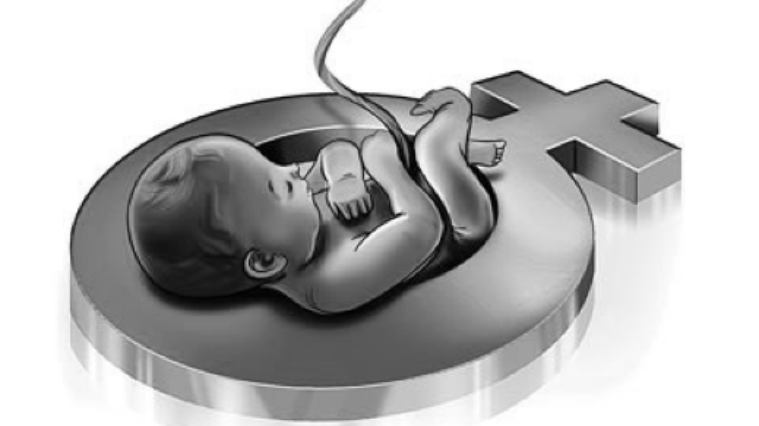
Female Foeticide
This is a major social problem in India and has cultural connections with the dowry system that is ingrained in Indian culture, despite the fact that it has been prohibited by law since 1961.
Female foeticide is in practice in India from the time of advent of technological advancements in medical field like prenatal sex determination in the 1990s.
In the Indian society, female childs are considered as the social and economic burden to their parents so they understand that it is better to kill them before birth.
The female sex ratio in comparison to the males has been reduced to a great extent.

Slide 21
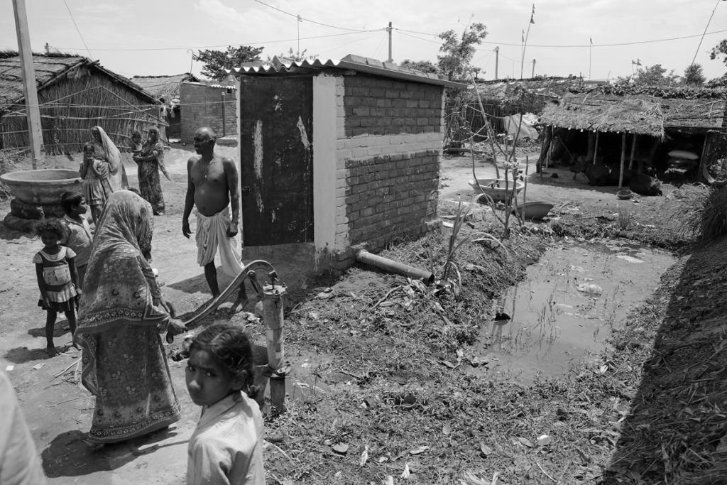
Sanitizing
The sanitation crisis and the recent evidence on lack of toilet facilities
One of the biggest problems facing the sanitation sector is lack of access to sanitary toilets to a large proportion of rural households.
Lack of access to water supply and drainage facilities and implications for sanitation
In addition to more than half of Indian homes having no toilets within their premises, access to water supply and drainage facilities is also another serious problem. For example, two-thirds of Indian homes have no drinking water facility from a treated tap source.
The still widespread practice of manual scavenging.
Over 1% of all households in both the urban as well as rural areas continue to rely even today on this practice.

Slide 22
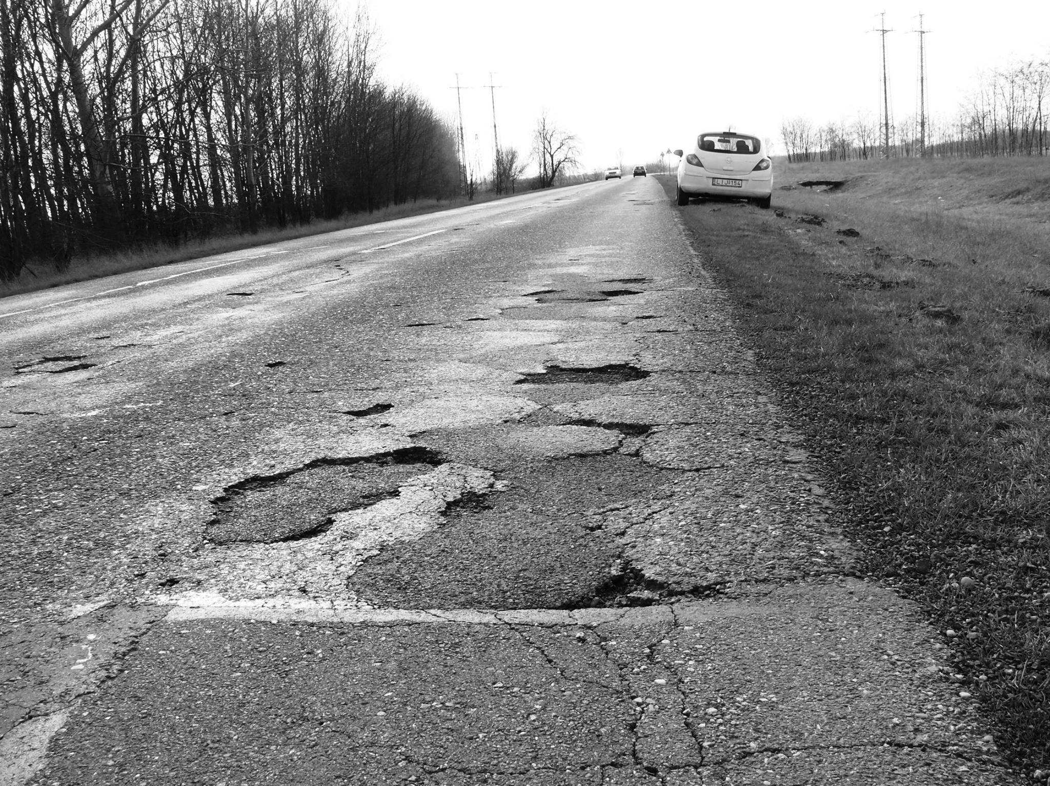
Transport
A major constraint with developing and maintaining rural roads is the fact that they are, unfortunately, rural. The areas where they are needed are often difficult to access, logistics become complicated, local contracting capability is limited, engineers are few and far between, and younger engineers especially, are not keen to leave the urban environment.
Design simple, high error margin techniques with low maintenance regimes
Use local materials as much as possible
Remember the cheapest option is probably the worst option no matter what the economic analysis or traffic volume figures indicate.
Short road-life expectation due to erosion and wear
Lack of drainage and watercourse crossings
Damage to health and detriment to farming productivity from dust
Damage to road users and equipment from rough roads.

Slide 23
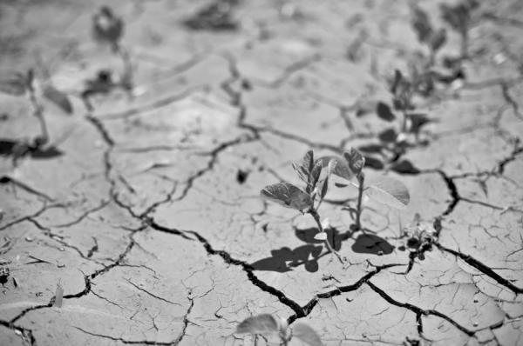
Agriculture
Agriculture, the backbone of Indian economy, contributes to the overall economic growth of the country and determines the standard of life for more than 50% of the Indian population.Agriculture contributes only about 14% to the overall GDP but its impact is felt in the manufacturing sector as well as the services sector as the rural population has become a significant consumer of goods and services in the last couple of decades.
Fragmented land holding
Irrigation problems
Seed problems
Sustainability problems
Over dependence on traditional crops like rice and wheat
Supply channel bottlenecks and lack of market understanding

Slide 24
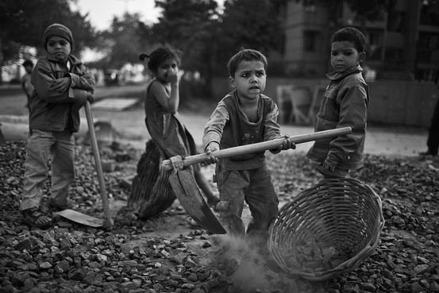
Child Labour
Children are exploited and are made to work in dangerous places like cracker factories. They are not treated properly.
Like other social evils there are rules and laws made to stop the child exploitation but nothing has been ever properly implemented in India and hence you can still see teenagers and children working in the shops and factories.
Child labour in India is to be found in almost every sector of the informal economy. Children are to be found working in workshops and small factories, in dhabas and restaurants, on the streets as well as domestic servants.
Moreover, since it is primarily girl children who work at home assisting in the household tasks of cooking, cleaning, washing, etc. It is here that engendering of the development strategy links up with the rights of all children who are out of school.

Slide 25
Persona , Customer Journey & Empathy Mapping

Slide 27
STAGES | NEEDS | DISCOVERY | INTERACTION | POST INTERACTION
COUSTOMER JOURNEY | Proper roads and transport facility. Free education. Equal rights Affordable medical expanses Clean water hygienic satinare Daily basic resource | Paro is married in a poor family in LOHAN VILLAGE. In that village she has to face many problems. Due to begin married in join family, women of that family don’t get equal rights. Due to lack of resources she has to face Problem in her day-to-day activity. Due to lack of hygiene she can’t live a healthy life. | She start her day early 4 in morning and walk 2km daily to use public restroom. Then she clean whole house. After that she cook meal for whole family. Then she spend whole day by doing beading of others. Because of this she can’t live a proper healthy life. She just want equal rights and a healthy life. | She has to do work whole day. Sometime when she is ill then also she has to work whole day. Irrespective of hard working day she does not get respect which she deserver. She is not allowed to speak in public and is allowed to speak in front of man of house.
DIGITAL TOUCH POINTS | ___ | __ | __ | __
PAIN POINTS | __ | Can’t get proper hygiene. Lot of work | Lack of hygiene. Not a healthy life. | Lack of hygiene. Not a healthy life. Don’t get respect which she desirve.
FEATURES | __

Slide 28
Think​ & Feel
Optimistic ,Mentally strong.​
Sometimes stressed &frustrated.​
Busy and hectic.
Discriminated
​
See​
She is illtreated.
Being Discriminated.
Does not have proper hygiene.
Doesn’t get any right
Hear
Always get abused by elders.
Own children does not respect her.
Husband always drink and used to abuse her mentally and physically.
User
Say & Do
Do whatever elder ask her to do.
Complete all the wishes made by her husband
and children.
Never complain about how they treat her.

Slide 29
Rural Development
The people of India live mostly in rural areas (villages). Therefore, it is in the heart of the villages that the nation lives. Indeed, “the soul of India is in the toil of the rural areas”. The welfare of India depends upon the prosperity of the villages.
After our independence, the conditions of the villages have been improved. The problems of our villages are many and various. For their solution, intelligent guidance of both the government and the people is needed.
The ways and means of rural development:
Education of the masses
Establishment of night schools for adults
Improvement of sanitation
Provisions for cheap medical aid
Construction of good roads
Establishment of co-operative credit societies

Slide 30
Components of Rural Development
Rural development seeks to transform all the sectors of rural economy – the primary sector, the secondary sector and the tertiary sector.
It is concerned with the improvement of the standard of living of the rurality’s through the provision of health and medical facilities, employment opportunities including vocational training, educational facilities etc.
It brings about significant improvement in the socio-economic conditions of the scheduled castes, scheduled tribes, the landless agricultural labourers and the marginal and small fanners.

Slide 31
Essential Aspects of Rural Development
Agricultural development constitutes the crucial aspect of rural development. Agricultural development is possible through the use of better seeds, adequate fertilisers, manures, and pesticides, adequate supply of water and effective implementation of land reform measures.
The success of the rural development programmes depends on the co-operative orientation and attitude among the rurality's. The functioning of the co-operative societies goes a long way in improving the conditions of the vulnerable sections of the rural set-up.
Rural development programmes demand the active participation of the rurality's. While formulating these programmes the opinions, attitudes, drives and interests of the rural people should be taken into account. Further, dedicated and committed village leaders should come forward to guide the masses for bringing about rural development.

Slide 32
Integrated Rural Development
It is claimed that the concept of Integrated Rural Development was originally propounded by the World Bank. In India the concept was put forward in the year 1976 at the All-India Science Congress by C. Subramanyam, the then Finance Minister of India.
He viewed integrated rural development as “systematic, scientific and integrated use of all our natural resources and as a part of this process enabling every person to engage himself in a productive and socially useful occupation and earn an income that would meet at least the basic needs.”
He holds the view that the use of natural resources is possible only through the application of science and technology. Further, proper application of science and technology results in the fulfilment of basic social needs.
G. Parthasarathy refers to four ‘routes’ in the context of integrated rural development:
(i) the institutional route of Gunnar Myrdal, (i ) the ‘New Economics’ route, (i i) the Neo- Marxian route and (iv) the Gandhian route. V.K.R.V. Rao defines integrated rural development as “the optimum utilization of the natural and human resources of a given rural area for the enrichment of the quality of life of the population.”

Slide 33
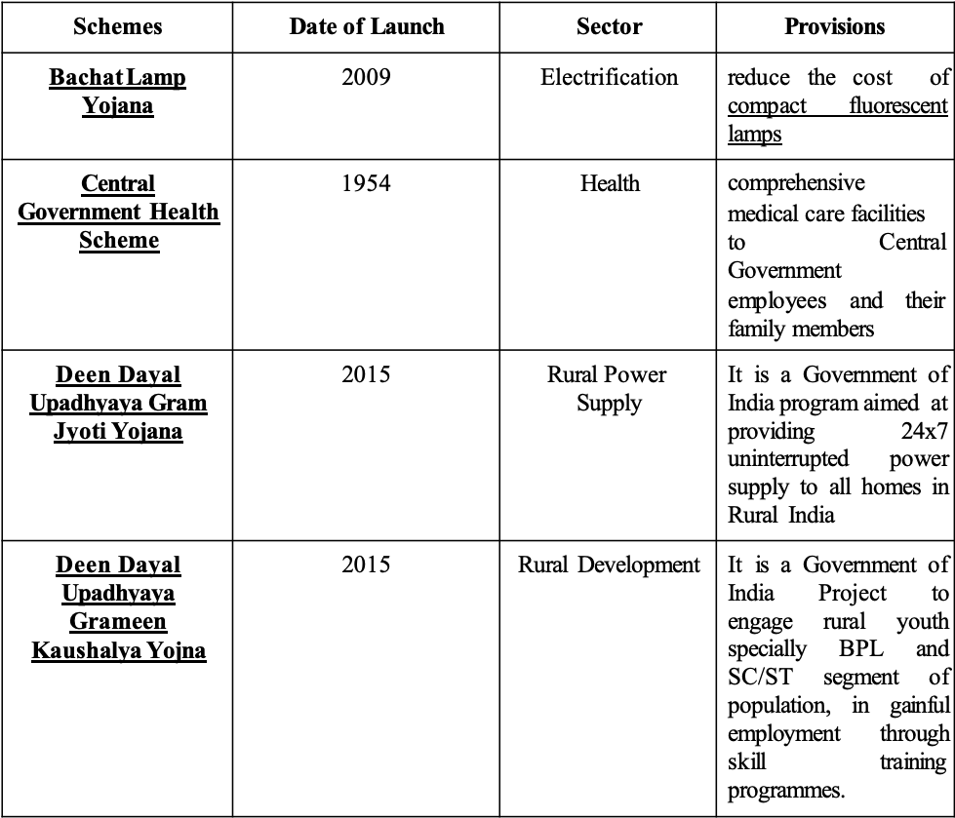
List of Government Schemes for Rural India

Slide 34
CONCLUSION
No doubt, villages are in a state of neglect and under-development, with impoverished people, as result of past legacies and defects in our planning process and investment pattern. But the potential in rural India is immense. What if every village in the country is provided with basic amenities, like drinking water, electricity, health care, educational transport, communication and other facilities, with only a smaller population of the village engaged in agriculture and the remaining in other gainful occupations? When this happens India will turn into mighty country. The purchasing power of the rural population throwing enormous demand for goods and services will boost the national economy tremendously. The day will see the reverse migration of people from the urban slums back to the villages. Rural Development is the subject to come to the forefront after the economic reforms and rural banking will serve the backbone of this development.

Slide 35
Thank You Presented By: Tarun Mittal 1710991839

